Slide 1

Anime Recommendation System

Slide 2
Introduction:
It might be hard to find an anime that fits your taste, you might ask your colleagues and friends to recommend things for you ,but you might not like what they recommend.
This project aims to help people with finding a list of anime for there taste based on genres they like or ratings of other users who liked the same stuff.

Slide 3
Problems we faced:
We didn’t know from where we could start, we found algorithms that used neural networks, regression ,and other ML ways which we didn’t understand very well
But we were not disappointed and we managed to make an algorithm using similarities and dissimilarities matrices, to predict similar animes

Slide 4
The Content-Based Method:
Content based is based on the animes itself, the genre and the story of the anime and doesn’t depend on human input to begin with.
Its useful for a starting website since there would be no user input in the beginning
We use TF*IDF algorithm which finds the frequency of the genres that the user watched and compare it with the entire data to find things with correlated genres.
Vector space model is what we use to store the results of TF*IDF.
We then use Cosin similarity to chose the similar genres with each other.

Slide 5
The Collaborative based Method:
We recommend for the user animes based on other user ratings, to do so we need the algorithm predict what rating would the user give to an anime
To do this we need spars matrix/utility matrix and we need the frequency of the ratings and we need the mean of the ratings
We also use the KNN (k-nearest neighbors) which uses Cosin method as a distance measure and we measure the distance between every anime and its neighbor and the we chose the nearest.

Slide 6
Spars matrix:
The spars matrix is an MxN matrix where M corresponds to the amount of animes and the N corresponds to the amount of users.
We map the Anime ID to index and user ID to index to make a spars matrix which has every user and every rating they rated for each anime including animes they have not rated yet (which will be evaluated by the algorithm).

Slide 7
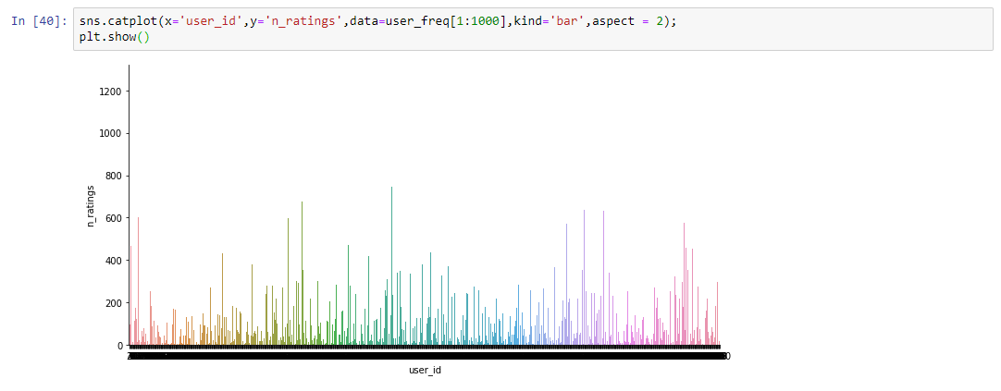
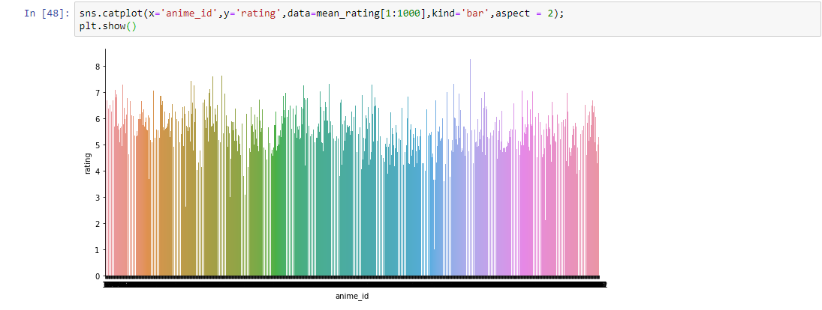
Some visualizations:
As we see we plotted the frequency of ratings
And we plotted the mean of rating for animes

Slide 8
Sources:
Content based : https://youtu.be/ijtxuF_5kEU
Collaborative based : https://www.youtube.com/watch?v=h9gpufJFF-0&list=PLLssT5z_DsK9JDLcT8T62VtzwyW9LNepV&index=43&ab_channel=ArtificialIntelligence-AllinOne
Data : https://www.kaggle.com/datasets/CooperUnion/anime-recommendations-database

Slide 9
END OF PRESENTATION

